Slide 1

Software Design and Analysis
Lecture 1- Introduction

Slide 2
Agenda
Instructor’s Introduction
Course Introduction

Slide 3
About the instructor
Instructor Name: Mehroze Khan
Email address: mehroze.khan@nu.edu.pk
Office Location: CS Department, MFO-009
Office Hours: Tue (11-12 PM), Fri (12-1 PM)

Slide 4

About you?
Introduce yourself
Name
Hobbies
Expectation from this course
Future Goals

Slide 5
About the Course
Software Design and Analysis ( CS-3004)
Data Structures (Prerequisites)
Your Expectation?
Theoretical?
Major engineering problem today
Predictable development of reliable software system

Slide 6
Software Design and Analysis
Introduction to basic concepts of object-oriented paradigm.
Elicitation of requirements through use cases, identification of domain concepts through domain model, selection of classes and assigning roles and responsibilities to various classes.
Focus on training by applying UML 2.x notation to fundamental OOAD concepts objects, classes, components, subsystems, stereotypes, relationships, supporting diagrams and design patterns.

Slide 7
Why SDA ?
Take a minute and think of the projects that you worked on.
Did they have a good design? Could the design be done better?

Slide 8
Why SDA ?
Take a minute and think of the projects that you worked on.
Did they have a good design? Could the design be done better?
Was there even a design at all?

Slide 9
Why SDA ?
Take a minute and think of the projects that you worked on.
Did they have a good design? Could the design be done better?
Was there even a design at all?
How do you know if the software was well-designed?
Notes:
Think of how easy it was to make changes to your code.
Did a small code change produce a ripple-effect for changes elsewhere in the code?
Was your code hard to reuse?
Was the software difficult to maintain after a release?

Slide 10

Good design isn't just about code.
It is about being able to express ideas for your software with other developers, other teams, and your clients.

Slide 11

Having a well-thought design makes your software easier to implement, reduces a need for major changes later in the project and it saves you from headaches down the line.

Slide 12
Why SDA?
Software Design Analysis will help your software become
flexible
reusable
maintainable

Slide 13
What is software design analysis?
How does it improve your software products?

Slide 14
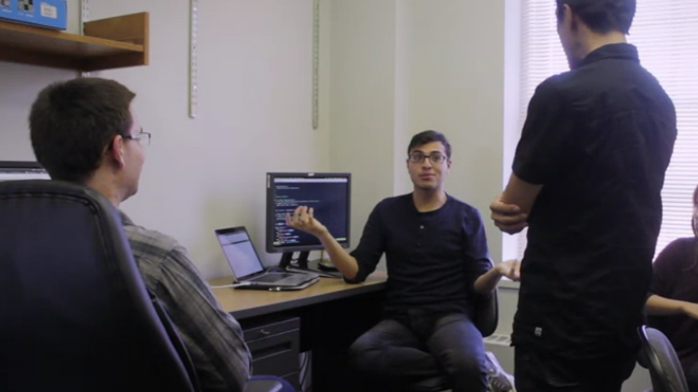
Scenario 1
You join a project that's been in development for a while.
You look at the code and become instantly overwhelmed.
You can't tell what the purpose of the pieces are, things are unorganized and design documentation is non-existent.
You don't even know where to begin. These are all signs that the project was not well-designed.

Slide 15

Scenario 2:
You are now working on a personal development project.
When you began, you weren't quite sure what the functionalities would be, but you just started coding.
It didn't matter that the code was unorganized because you were the only one working on it and you know how it works.
You came up with a great new feature for your product, but in implementing it, you broke the program elsewhere.

Slide 16
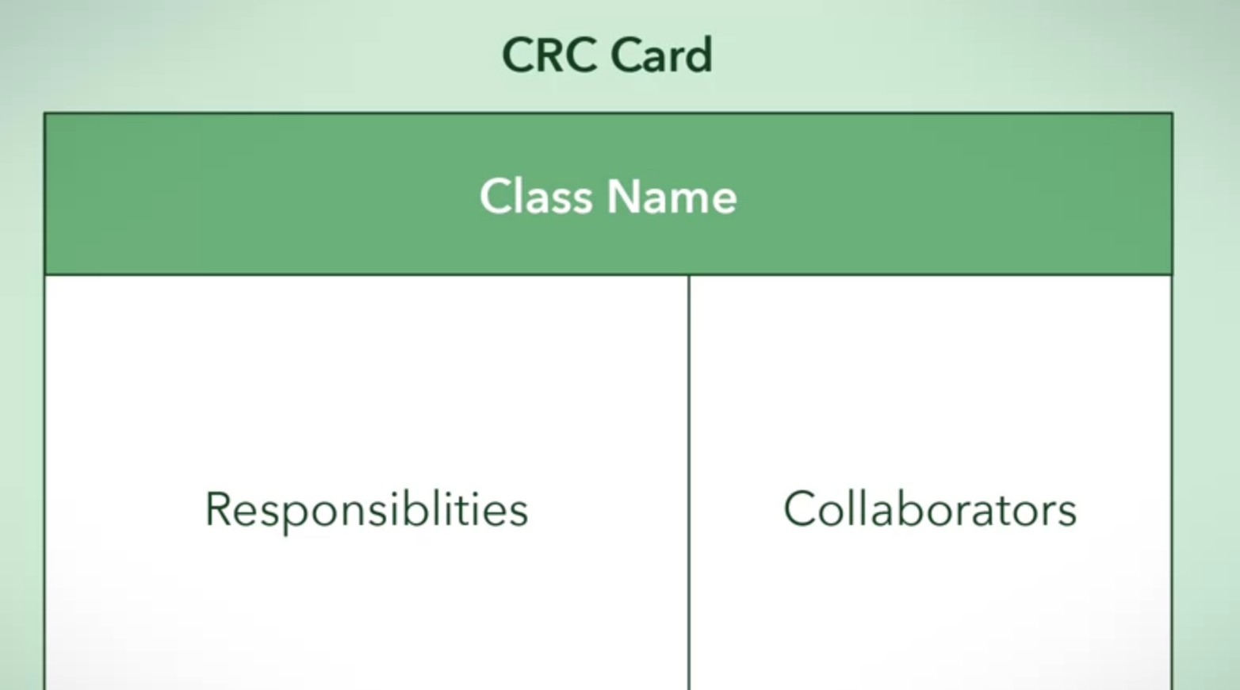
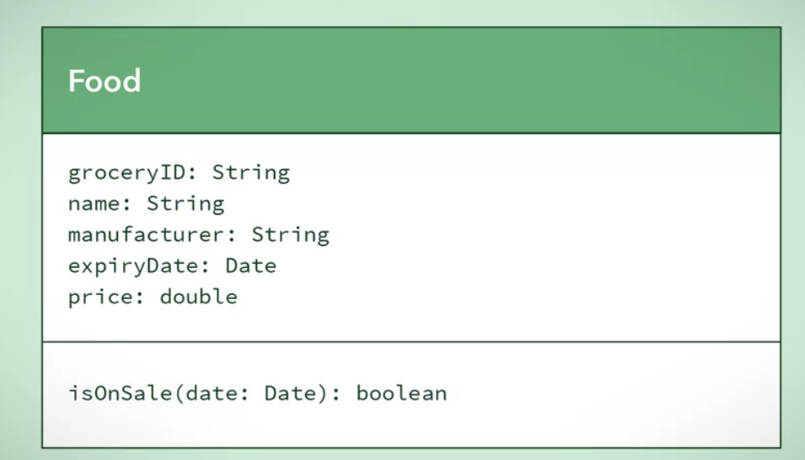
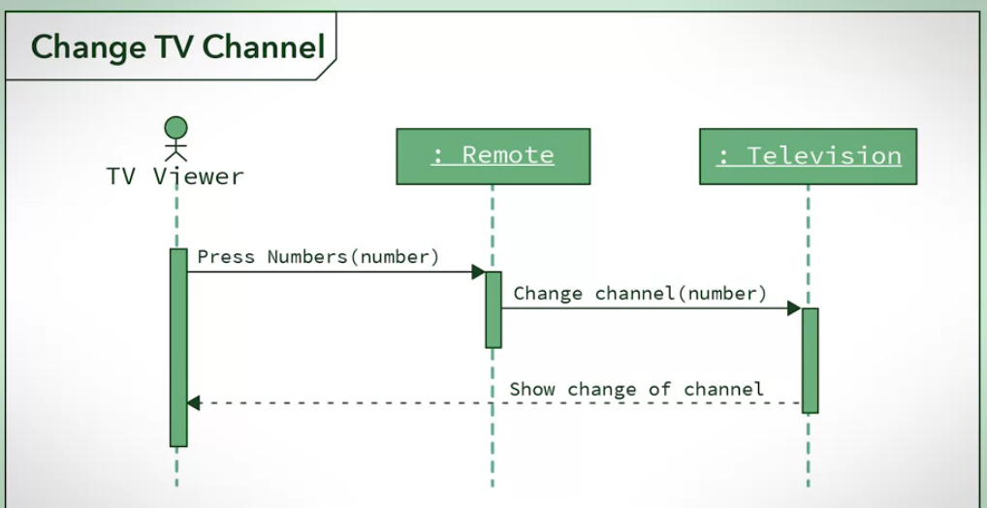
Course Design
How to express in document the design and architecture of a software system using a visual notation

Slide 17
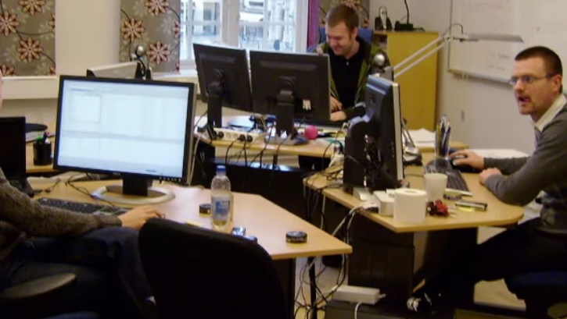
SDA role in industry
Like many roles in the software industry, the software designer or a software architect role can look very different from company to company.
Characteristics like company size,
the scope of the project,
the experience of the development team,
the organizational structure and
the age of the company can all impact what these roles look like

Slide 18
In some companies, there may be a distinct role for a software designer or architect.
In other companies, the design may be completed by a member or members of the development team.

Slide 19
Great software designers and architects are detail-oriented, forward thinkers.
They need to be able to see the product at both the low and high levels.
They need to be creative problem solvers in order to come up with a quality solution for the problem at hand.
And they need to be able to express these ideas effectively with the product manager and the development team.

Slide 20
SDA
Object Oriented Design
Design Patterns

Slide 21
Thanks

